Slide 1
Network Performance Prediction System
📡📡📡📡
Ooreedoo Technical test
Presented by Mahmoud ALBARDAN
1 May 2025

Slide 2
Plan
Context and objectives
Data processing
OSS counters forecasting
Performance degradation classification
Impact on business
Deliverable

Slide 3
Context and objectives
The use case is to build a network performance prediction system using OSS counters data 4G LTE cells recorded at 15 mins interval
To that end we built two types of models:
OSS forecasting models for each (cell/oss counter)
Prophet model
Classification model to predict whether a cell activity is "usual" or "unusual" Gradient boosting classifier

Slide 4
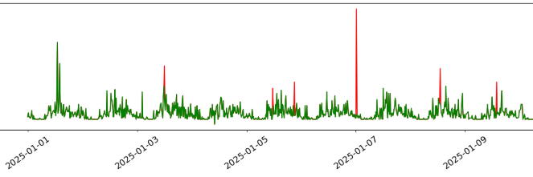

2. Data processing
The data contains 33 cells and 11 OSS counters describing (PRB, throughput, Number of users )
Issue1: Data includes only time (example: "08:45")
Solution: Day column is created by indexing repeated times and full datetime are generated by considering Day 1 as 2025-01-01
Issue2: Some datetime are missing:
Solution: Resample data at 15 mins to create rows for missing datetimes then do a linear interpolation to fill missing OSS counters
Issue3: Outliers are detected (via z- score method)
Solution: Convert outliers to nan then do a linear interpolation to fill them

Slide 5
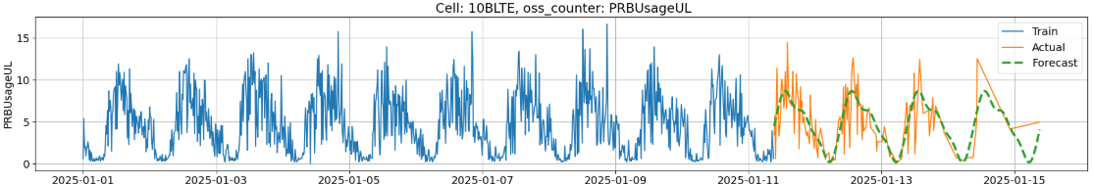
3. OSS counters forecasting
One Prophet model per cell/oss counter
Most of cells has 14 days data recorded at 15 minutes
10 days is dedicated for training, 4 days for validation
Three Metrics:
Roote mean squared error (RMSE)
Mean absolute error (MAE)
Mean absolute percentage error (MAPE)

Slide 6
4. Performance degradation classifier
One Gradient boosting classifier model to detect whether a cell activity is usual or unusual
Feature engineering:
Add rolling mean/max of OSS counters for different window sizes (1h, 5h, 7h, 15h)
Add DL/UL ratio features for PRB, Throughput and number of users
Cross validation with 5 folds with metrics: f1 score, precision, recall and accuracy
Specify optimal prediction probability based on the maximal f1 score

Slide 7
5. Impact on business
Network optimization by anticipating performance issues
Prioritizing maintenance or upgrades
Improving customer experience if we add a congestion detection step

Slide 8
6. Deliverable
A Github repository (mahmoudalbardan/NetworkPerformanceAnalysis)
that you can clone then train models and launch gradio app in http://127.0.0.1:7860/
Gradio Dashboard

